Slide 1




Chatbot for Travel Planning
Welcome to the world of personalized travel planning! This chatbot utilizes cutting-edge Large Language Models (LLMs) to help you craft unforgettable trips.
by Farid Ghorbani

Slide 2
The Problem
Travel planning often involves navigating a sea of information, from destination research to itinerary creation.
Destination Selection
Activity Planning
Choosing the perfect destination can be overwhelming, considering factors like interests, budget, and time constraints.
Deciding on activities, tours, and experiences to fill your itinerary requires extensive research and planning.
Accommodation Booking
Travel Tips & Information
Finding suitable accommodation options within your budget and preferences can be time-consuming and challenging.
Accessing reliable travel tips, visa requirements, local customs, and other essential information can be difficult.

Slide 3
Our Solution
Our chatbot leverages AI to help you overcome these challenges, providing personalized recommendations and streamlining the planning process.
1
Personalized Recommendations
2
Detailed Itineraries
The chatbot understands your preferences and offers tailored suggestions for destinations, activities, and accommodations.
It helps you create detailed itineraries, including suggested activities, transportation, and dining options.
3
Travel Tips
4
Engaging Conversation
The chatbot provides useful travel tips, including visa requirements, local customs, and safety information.
The chatbot interacts with you in a conversational tone, making the planning process enjoyable and interactive.

Slide 4
Technology Stack
The chatbot is built using a powerful combination of front-end and back-end technologies.
Frontend
Backend
Streamlit provides a user-friendly framework for creating intuitive web applications.
Ollama, an LLM running locally, handles the natural language processing and provides insightful responses.

Slide 5
Implementation Steps
1. Environment Setup
Install necessary dependencies, including Streamlit and Request liberaries.
Configure the Ollama LLM model on your local machine.
Install Ollama from: https://github.com/ollama/ollama?tab=readme-ov-file
Start your local instance of the LLM service: ollama serve --model llama3
to create a robust development environment.

Slide 6

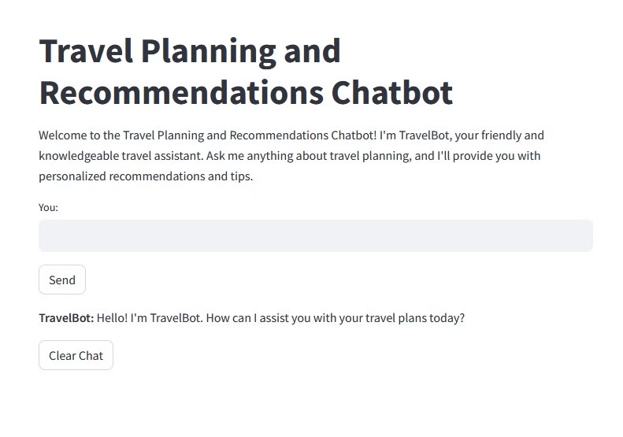
Implementation Steps
2. User Interface Design
Build an intuitive and engaging user interface using Streamlit components like text input, buttons, and markdown.

Slide 7
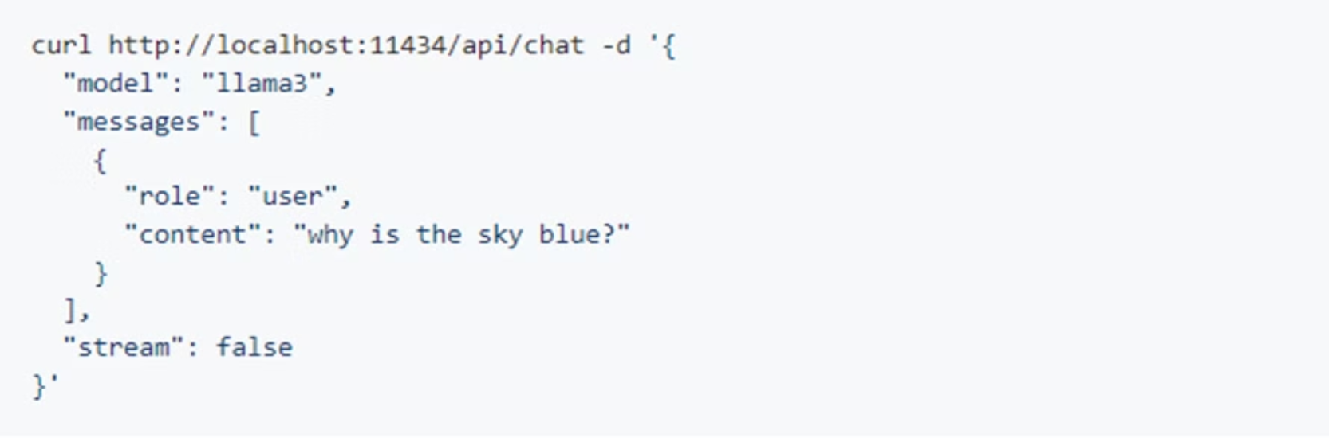
Implementation Steps
3. LLM Integration
Connect the chatbot with the Ollama LLM model using its API to enable natural language processing.

Slide 8
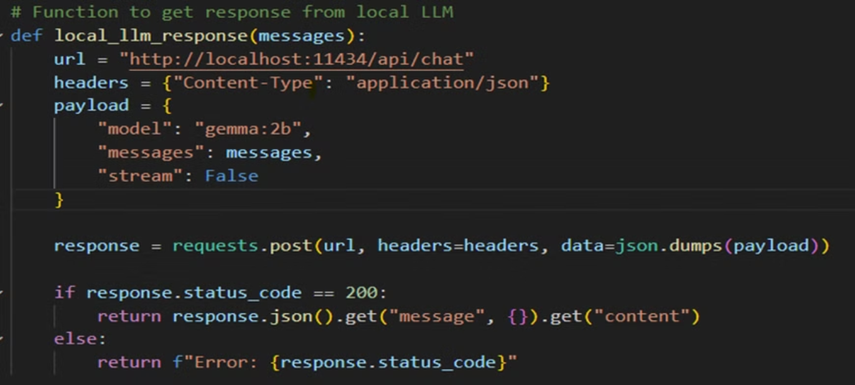
Implementation Steps
4. User Query Handling
Implement functions to process user inputs and generate responses using the LLM, providing personalized recommendations.

Slide 9
Implementation Steps
5. Testing and Evaluation
Thoroughly test the chatbot with various queries to validate its accuracy and usability, gather user feedback, and refine its performance.

Slide 10


Prompt Design
The chatbot's personality and communication style are crucial for creating a positive user experience.
Persona
Communication
The chatbot adopts a friendly and knowledgeable travel assistant persona named TravelBot.
TravelBot maintains a conversational and engaging tone, providing helpful guidance and recommendations.

Slide 11
Prompt Example
The prompts are carefully designed to ensure TravelBot provides accurate and relevant information.
You are a helpful and knowledgeable travel assistant named TravelBot. Your goal is to help users plan their trips by providing personalized recommendations for destinations, itineraries, activities, accommodations, and travel tips based on their preferences and queries. Maintain a friendly and engaging tone throughout the conversation.

Slide 12

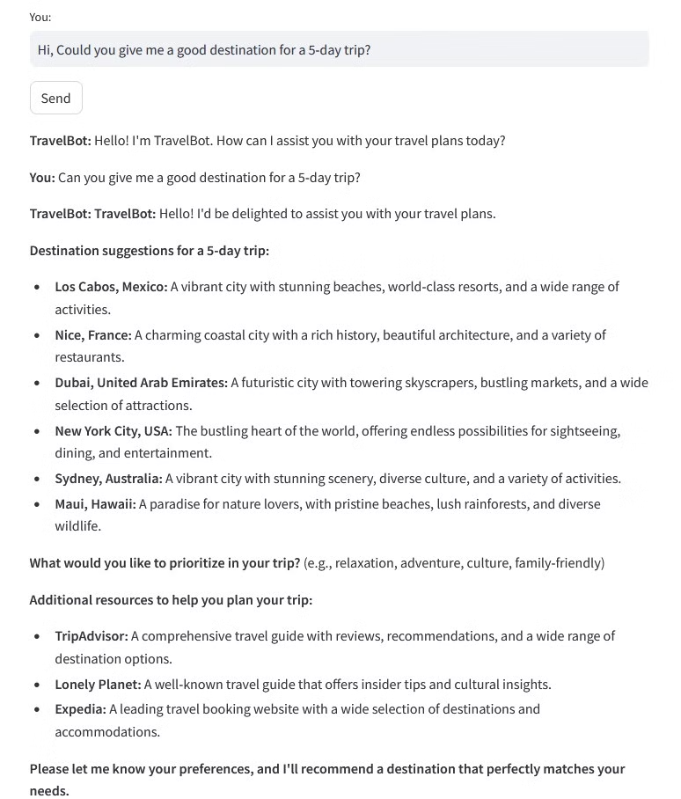

Result
The chatbot delivers personalized travel recommendations, detailed itineraries, and helpful travel tips.
User Query
Could you give me a good destination for a 5-day trip?

